Slide 1
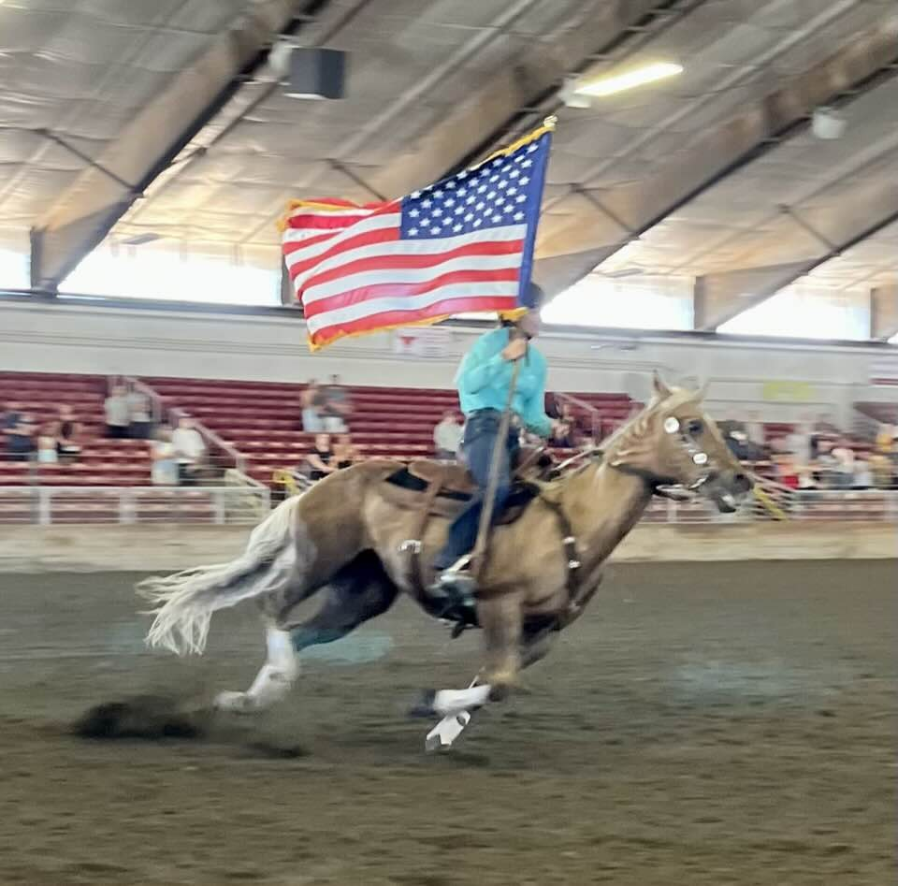
Prepare for Fair Presentation

Slide 2

Where the Magic Comes Alive in 2025
Melinda Nelson, Superintendent
425-737-2700
Laurie Johnson, Assistant Superintendent
206-930-3844
Jennifer Munson, Assistant Superintendent
425-471-4532

Slide 3
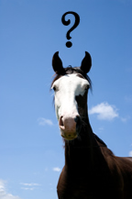
You decided to go Fair….
NOW WHAT??

Slide 4
Fair Requirements
Be a current member as of March 31st
Have a horse certificate on file
Attended a Horse Judging –
Given a Public Presentation
Have an UpToDate Record Book
You must have shown the same horse & rider combination at a regular show for:
Western Games
Hunter Over Fences
Driving
Ranch Riding
If you have not shown the same horse & rider combination for the above disciplines at a regular shown contact the Show Chair to apply for a waiver

Slide 5
TIPS FOR SUCCESSFUL FAIR
Practice
Keep Record Books Up To Date
Watch Horse’s Health
Vaccines Recommended
Given @ Least 2 Weeks Prior to Haul in
Consult Vet for Recommendations
Check for Bot Eggs & Remove Them
Up To Date with Farrier
Watch for Skin Issues
De-Worm

Slide 6
Waivers & Hardships
Judging Waiver Request
If you did not complete one of the four Horse Judging, you may submit a judging waiver (signed by your club leader)
No Fair Premium Money will be Given
4-H Hardship Form
Loss of Horse only project, Injury, Loss of Lease, Sold or Unexpected Change
Copy of Completed Horse Certificate on Non-Project Horse
Signed by Member, Parent & Leader
Copy of Veterinarian’s Statement on Project Horse
No Fair Premium Money will be Given
CANNOT Qualify for State

Slide 7
Code of Conduct Dress & Grooming
Applies to:
4-H Members
Adult Supervisors
Enrolled Volunteer
Anyone in the Barns/Exhibit
Anyone Representing 4-H
When at Fair, we are representing Snohomish Country 4-H Horse Program to the Public
Clothing shall NOT be Revealing or Offensive in Nature
Straps on Sleeveless Shirts Must be 3 fingers wide or wider (approx. 2”)
No bare midriffs, or low-cut tops or pants that reveal underwear
Shorts/Skirts must be NO shorter than tips of the fingers when arms held at the sides of the body
Any Slogan or Insignia on clothing that Implies discrimination, ridicule, intimidation or profanity is unacceptable
Any display of pictures in reference to or words depicting alcohol, tobacco, illegal substances or sexual innuendo on any clothing is unacceptable
Display of pictures in reference to or words depicting guns or weapons is unacceptable
Other Items deemed inappropriate by 4-H Facilitators, Representatives or Staff are unacceptable
IF IN DOUBT, DON”T WEAR IT

Slide 8


NEED TO KNOW
THEME
FLEXIBILITY AND PATIENCE
No food in aisles of barns
Fair Rules
No dogs in the horse park
No bikes, skateboards etc.
No overnight sleeping in the barns
No parking in fire lanes
See Fair rules for more info
Helmet
Ensure good fit
Hoof Black
May NOT do it directly on aisle - must use cardboard or other material - outside or in stall
Applies to:
✓
✓
4-H Members
✓
✓
Adult Supervisors
✓
“Withs” during shift
✓
Enrolled Volunteers
Anyone in the barns/exhibit
Anyone representing 4-H

Slide 9
NEED TO KNOW continued
Display of unsportsmanlike conduct is prohibited
Animal abuse of any kind is prohibited and will not be tolerated
Take out garbage and pack up food regularly to avoid rodents and insects
Smoking, use of tobacco, vaping, alcohol or drugs (other than those directed by a doctor) is not allowed
Language must be controlled and appropriate - no swearing, no behavior that would cause embarrassment (including excessive public displays of affection) or emotional, physical, verbal, mental or sexual abuse to others
Applies to:
✓
✓
4-H Members
✓
✓
Adult Supervisors
✓
“Withs” during shift
✓
Enrolled Volunteers
Anyone in the barns/exhibit
Anyone representing 4-H

Slide 10
Review Rules and Guidelines
Evergreen State Fair 4-H Horse Exhibitor’s Guide
Dept L
4-H Departments | Evergreen State Fairgrounds, WA - Official Website
State 4-H Equine Rule Book
Rule-Book-Updated-October-2024.pdf
Snohomish County 4-H Rules
Horse show etiquette
Refer to County Reference Guide
When and how to talk with the judge
Make arrangements with office after your section is complete
No coaching from the rail during a class

Slide 11
LEADERS
Fair Forms Need by XXXXXXX
Online Forms Can be Filled Out Online
Submit to Fairsuperintendent@snoco4-hhorse.com
Fair pass form submitted by July 22nd

Slide 12
FAIR, PARKING & RV PASSES
Fair & Parking Passes
Ordered as a Club for each member and parent that will be submitted by the Club Leader
Fairgrounds will send a link to the Clubs to Purchase
RV Reservation are done online by each family as needed
Fair RV Parking Application 2025

Slide 13
MEMBERS
Sign Up on ShowWorks
Must Enter by July 17th
Welcome to ShoWorks! Here is the link
Enter as Many Classes as You Wish
Walk/Trot Enters Only Walk/Trot Classes
Novice Enters Only Novice Classes
Regular Enters Only Regular Classes
Will be Paid for up to 9 Premium Classes
Costume & Versatility are Examples of NON-Premium Classes
Save Copy for Your Own Records
Must bring medical release Form and emergency vet form to orientation for each section you are attending

Slide 14
SCHEDULES
Fun Games
Times will be announced each Section if time allows for fun games.
Draft Horses
There is an evening show each day except Wednesday
Costume Class must be Ethnically correct, and you must have a lead person
Do not enter into Callback Classes online
These will only be used if we have big classes and need to have lots to divide the class size up
No cross entering – must stay in Regular, W/T/J, Novice etc..
Medals riders MUST be in advanced classes for the classes they are in medals for
Signup for Herds on ShoWorks during your section regardless of when you are scheduled with your club. You can get premium for 3 Herds days
Please listen to announcements for changes to schedules

Slide 15
Horse Shop Drop Off
Monday August 18th 4pm-7pm
Bring in your:
Photography
Paintings
Educational
Art work
Pottery
Drawings
Homemade tack
Homemade clothing
Crafts
Posters
Model Horse items
BE CREATIVE and HAVE FUN
SEE DEPT L FOR MORE DETAILS
ITEM MUST BE FROM THE CURRENT YEAR

Slide 16
Horse Shop Pickup
Pick up horse shop entries; horse photography; memorial posters and informational displays
Thursday – August 28th
From 1pm-3pm
Please ensure pick up happens – it is difficult for activity supervisors to take, store and arrange delivery of forgotten items. You may have someone else pick up for you.

Slide 17



Slide 18
DEMONSTRATIONS
Horse Shop Division
Department L – Horses
Entry deadline is Monday August 11
Online sign up only
sign up for times for demonstrations – see general schedule
DEMONSTRATIONS Class Code --Limit one (1) per exhibitor
2LB10 – Demonstrations for Juniors, Intermediates and Seniors
9LB10 – Demonstrations for Clover Buds

Slide 19
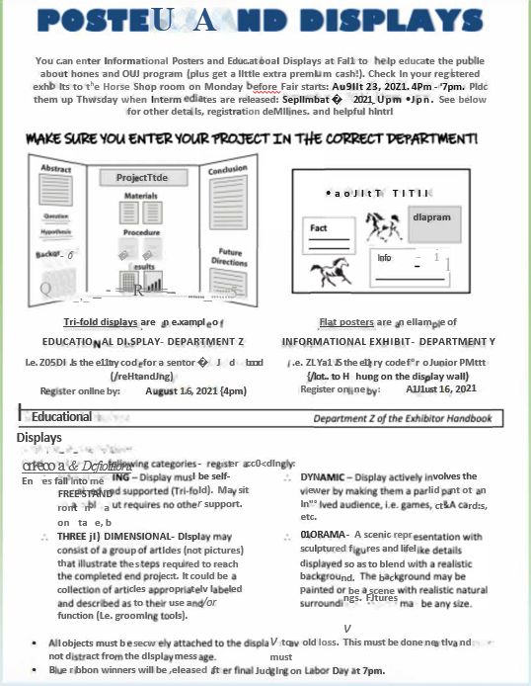

Slide 20


Slide 21
Groomsquad
Groom Squad Registration must be mailed or emailed in by the deadline on the form.
**Sunday August 17, 2025**
Registration must be postmarked by August 8th, 2025 or
Emailed by August 13th
E-Mail entries to: Monica Garbutt
sno.co.groomsquad@gmail.com
SENIOR TEAM CAN QUALIFY FOR STATE

Slide 22


Slide 23


Slide 24
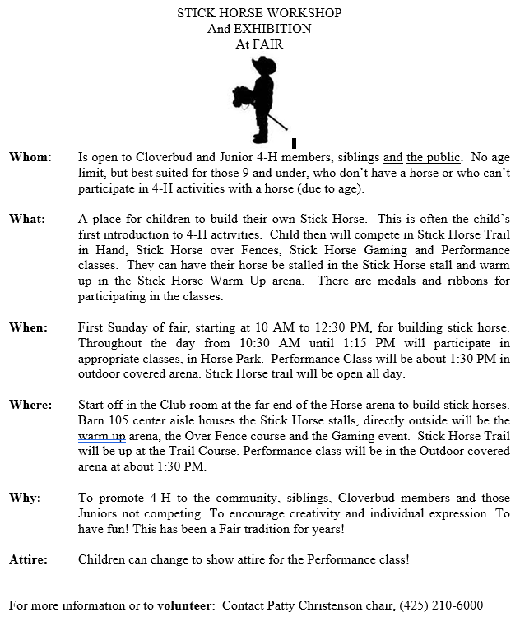
STICK HORSE WORKSHOP
August 24th
Build your horse from 10:00am until Noon
Show your horse from 11:00am through 2:00pm throughout the park
Performance Class at about 1:30pm in the Outdoor Covered Arena

Slide 25
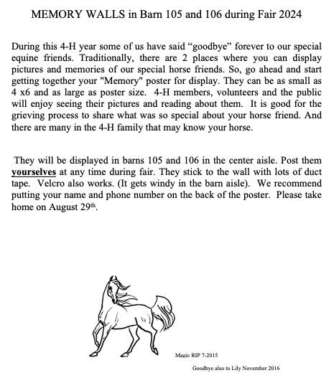
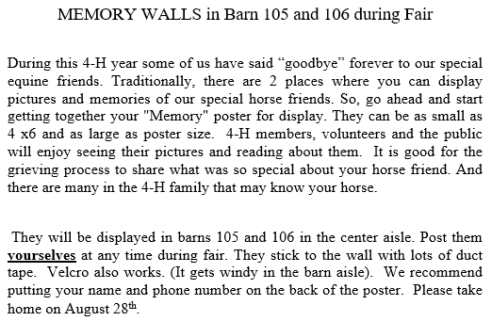

Slide 26
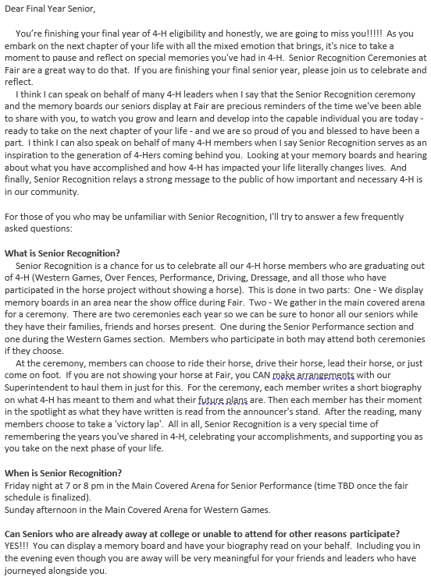
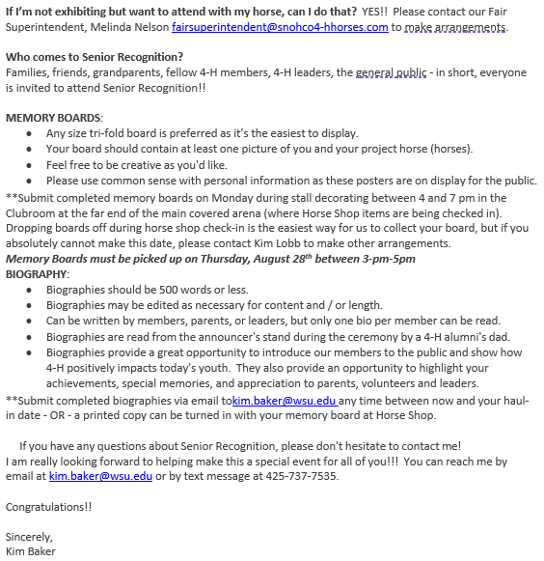
SENIOR RECOGNITION

Slide 27
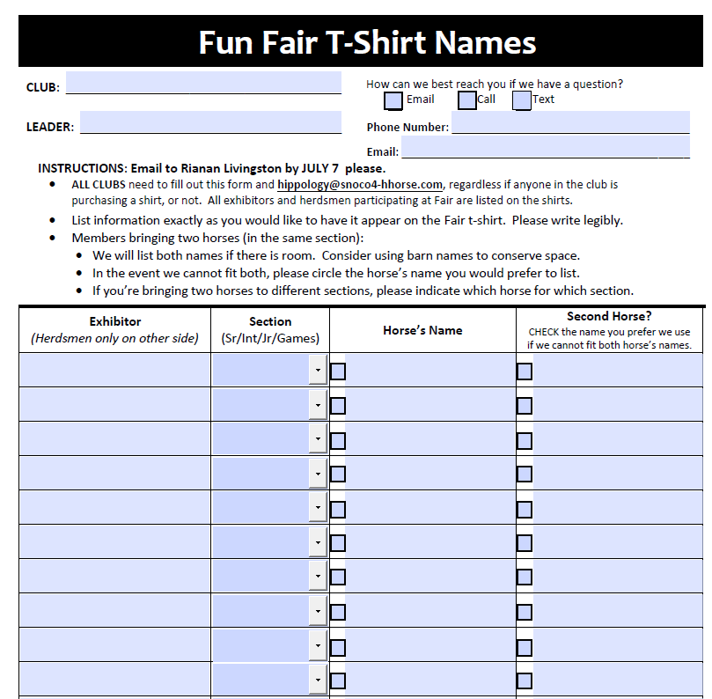

FUN Fair T-SHIRT

Slide 28
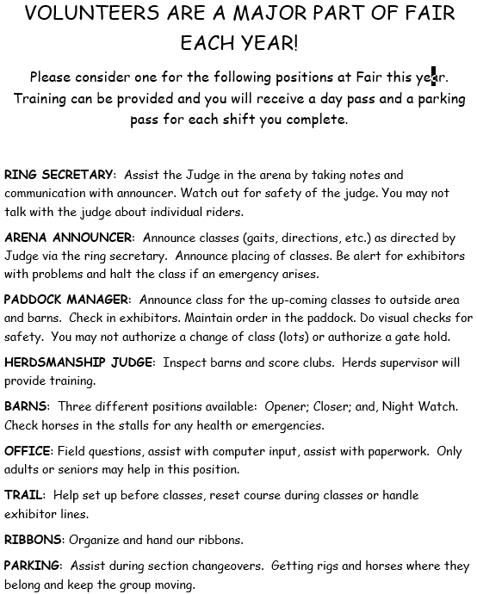
VOLUNTEERS
We will be using Sign-up Genius again this year for Fair
Below is a copy of the volunteer descriptions
Signup Genius
Watch the Facebook page for shifts available
Many positions DO NOT require the person to be an enrolled Volunteer!

Slide 29
Stall Preparation & Safety Check Sunday August 17th-August 20st
Pressure Wash and Disinfect (no bleach allowed) ask your vet for proper disinfectants
Sunday ONLY from
9am-3pm
Decorating begins at 3:00pm on Sunday the 17th
Ends on Wednesday the 20st
Must be complete before Fair opens
NO MORE SPRAYING WATER AFTER SUNDAY 3PM. This could damage others decorations
Remove Staples, Nails, Screws, Zip Ties, Twine, Tape, Gum, Wires, Hook from inside & Outside Stalls, Support Beams & Exhibit Area & Cords from Stall Areas
**Please do not blow dirt or garbage into another club's area
**Remove it from the barn
Report any Stall Repair Issues with stall number to Laurie via text at 206-930-3844

Slide 30
What to Bring
Club
Curtains
Valances
Décor
Ways to Hang
Ladder, Poles, Wire, Rope
Tools to Remove Nails, Tacks, Staples & String
Chairs
Totes

Slide 31
Stall Requirement
Valances on All Stalls Used by Club
Curtains to Cover All Tack / Changing / Equipment Areas
Information Poster on Each Stall
Member & Horse
Photos of Riders MUST Have Helmets
Educational Poster
Buckets
Horse
Two Buckets Hung with Snap Clip Facing AWAY from Horse’s Face
Mini
One or More Buckets
Can be On Ground IF Handle Secured or Removed
Gate is Allowed with Member Present
Halter & Clip to Secure Stall Door
If Bringing Hay Net, Holes CANNOT Be More than 2”

Slide 32
Haul In & Vet Check
Arrive with Following @ Hand
Signed Copy of Horse Certificate – Can be Digital
Enter the equestrian park from 179th Avenue between 5:30-7:30pm
Too Early? - You Will be Turned Away
Too Late? – Call Fair Superintendent (425) 737-2700
Follow the Directions of Fair & 4-H Volunteer Parking Crews
Horse Trailers Directed Behind Bard 106
All Others to Parking Lot
Driver Stops in Unloading Area
Unload Horse(s)
Driver Does not leave vehicle unattended
Horse & Member Go To Vet Check w/ Horse Certificate
Driver Leaves Loading Area
While Waiting for Vet Check – Keep Horses Apart & Avoid Petting Other Horses
Horses should be Naked for Vet Check – No Blankets / Sleezies / Boots
Members & Others Handing Horses MUST Have Proper Footwear – Hard soled enclosed shoes/boots
DO NOT UNOAD TACK or EQUIPMENT UNTIL TRAILER IS PARKED in PARKING AREA

Slide 33

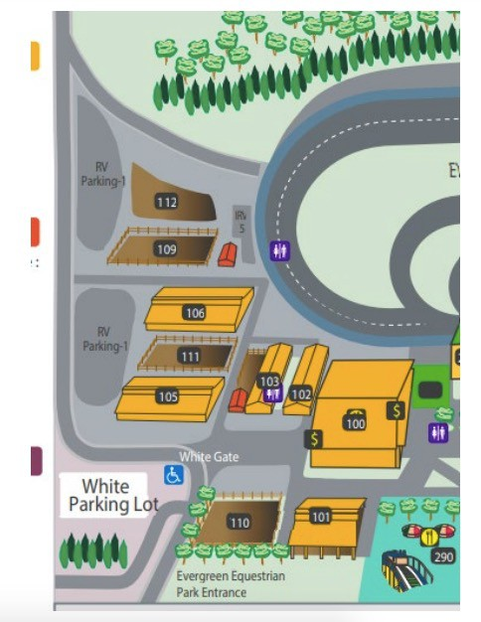
Follow red arrows
Trailers ^^
Stop to unload HORSE only

Slide 34
What to Expect in Vet Check
Temperature: must be under 101 to pass vet check, temperatures between 101 and 102 from trailering are allowed time to cool down and retest
Please make sure your horse allows temperature to be taken rectally
Pulse & Respiration
Mucus membrane color & Capillary refill time
Overall examination looking at the health and condition of your horse and a soundness check ( jog away and towards the vet)
Horses with infectious nasal or ocular discharge or other signs of infectious disease may not pass
Lameness, poor hoof care affecting gait, open wounds, girth galls/sore backs will not pass
Horses must be free from visible parasites (bot eggs, lice)
Henneke Body Condition Score (BCS) should be between 4 - 7

Slide 35
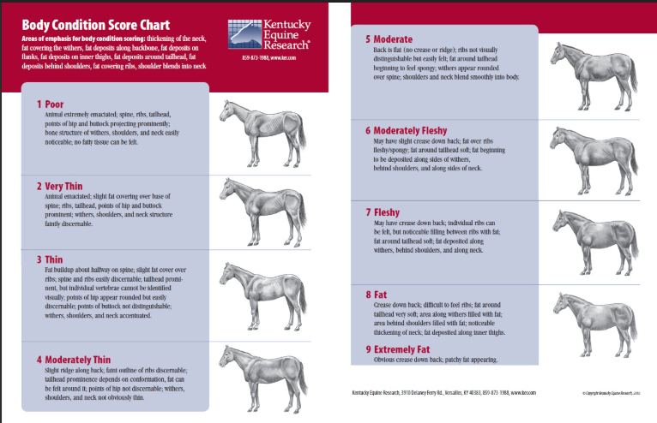
BODY SCORING Check

Slide 36
Stall Card
Display on Stall
Front Includes
Stall Number
Horse Name
Owner Name – First Name Only
Rider Number
If Horse has Odd or Aggressive Behavior
Back
Phone Number of Adult Financially Responsible for Vet Care
Description of Odd or Aggressive Behavior for Night Barn Crew
Stall Habits – May Bite, Lays Down Frequently, Pushy…
Horse Medications
If Relevant – RV Location on Fairgrounds

Slide 37
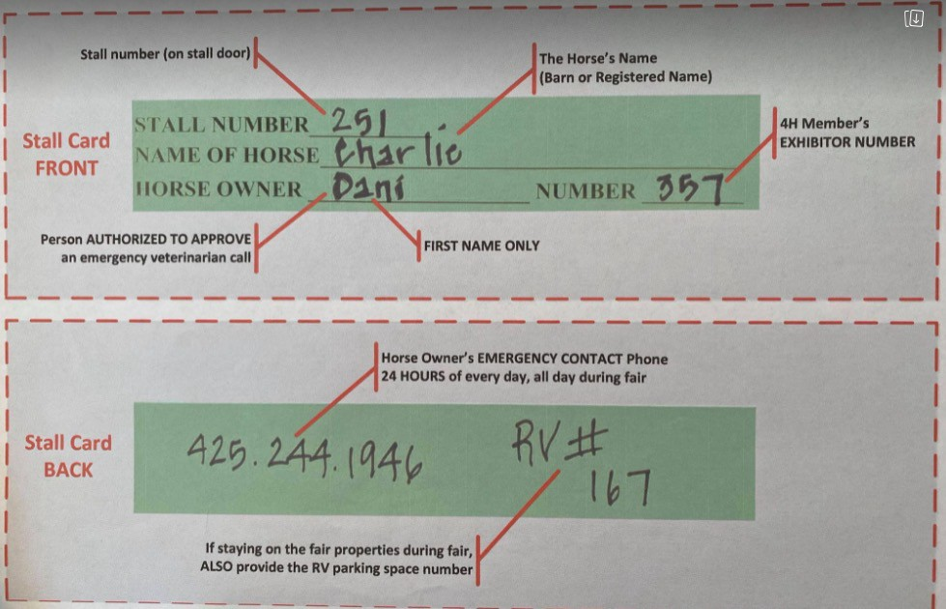
Stall Card

Slide 38
Pre Meeting
Go to the show office at Arena 100
Get you number and class schedule
Verify classes are correct
Get Manure / Water Chart (per section / per club)
Watch for patterns to be posted

Slide 39
Mandatory Orientation Meeting
Indoor Covered Arena 100
Pick Up Number
Verify Classes Are Correct
Classes Need to be Corrected BEFORE or AFTER Orientation Meeting on Haul in Night
Pick Up Manure / Water Chart for Club
Patterns for Following Day should be Posted
Bring
Medical Release Form & Emergency Vet Form
Remember to Add Stall Number to Forms
Meet
Fair Officials
Judges
Ask Questions & Learn What they would like to See

Slide 40
YOUR HORSE’S STALL
Stalls
2 Buckets per stall full of water (more allowed)
Minis can have 1 Bucket or more (ground is ok if handle is secured or removed)
Hay net less than 2” in diameter
Hay bag ok
Shavings – keep clean
Stall card (on door)
Valance
Informational Poster
Horse info / Rider info
Educational Poster
Mini Horses
Water buckets do not have to be hung
Gate is allowed for stalling with member present
Manure and Water Chart
Office will have these

Slide 41
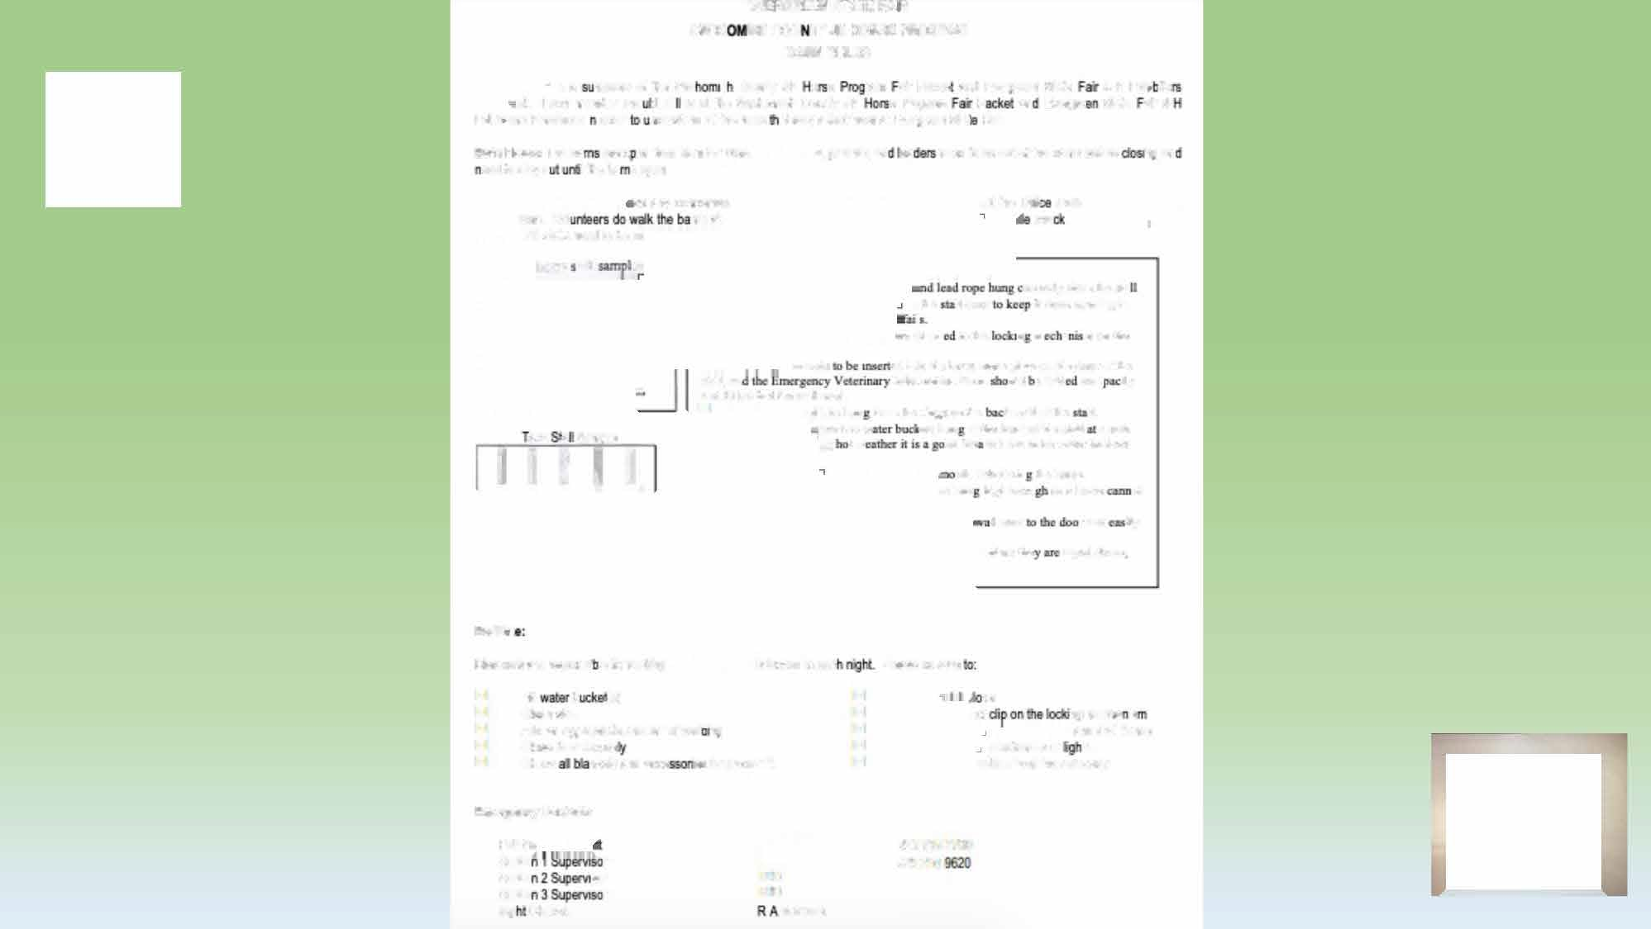

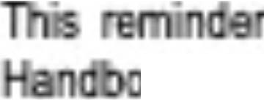

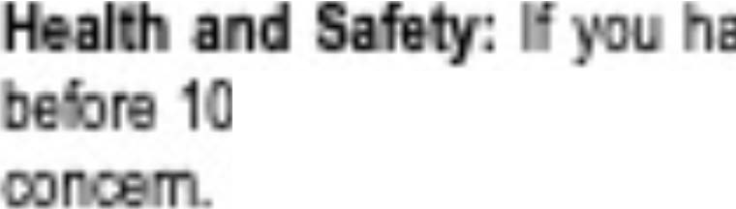
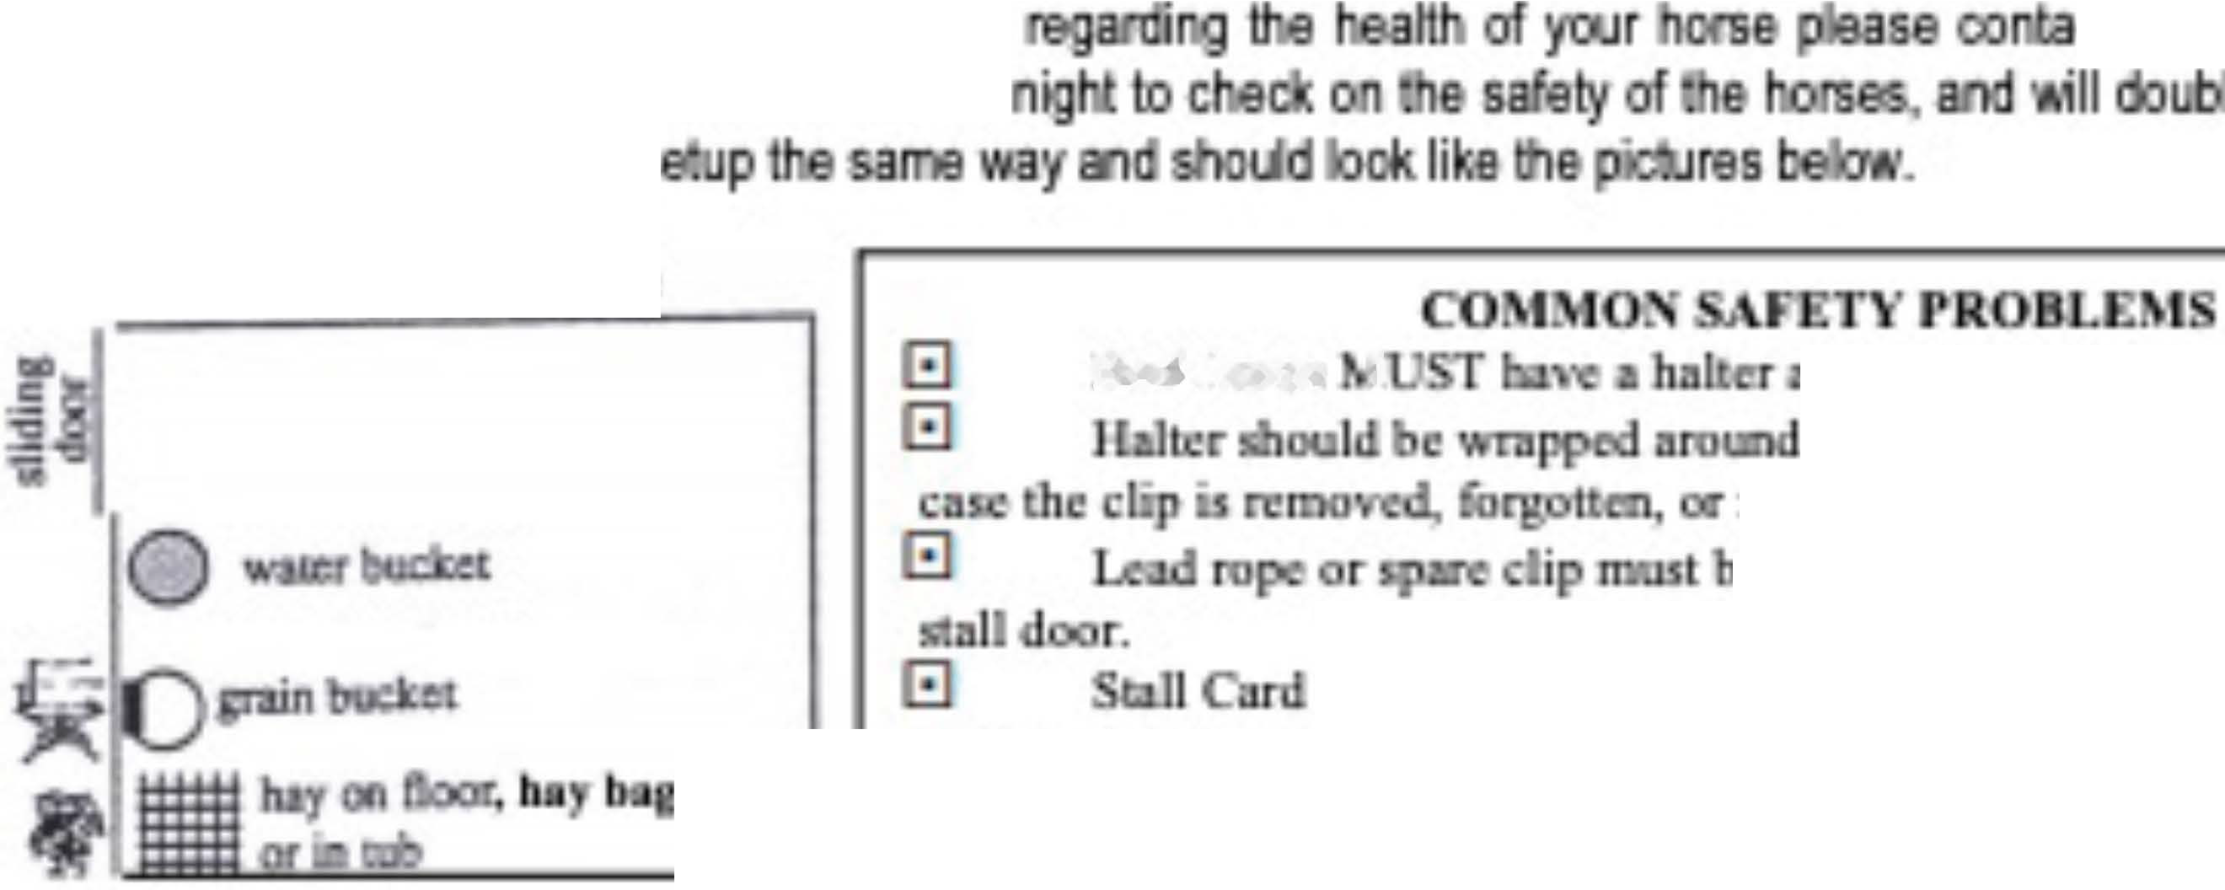
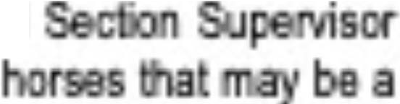
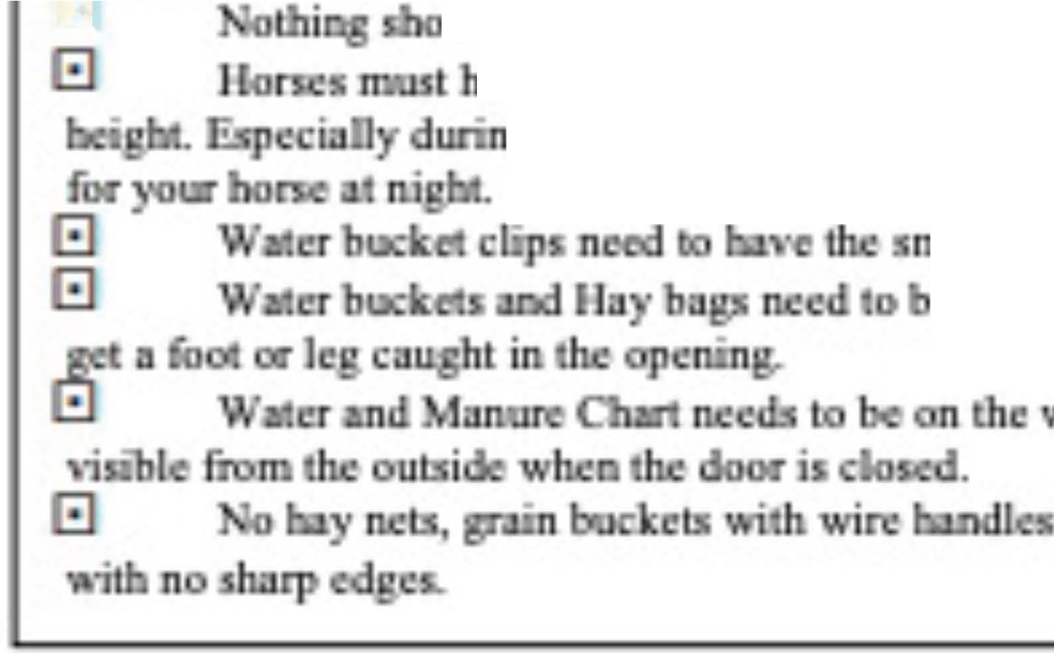
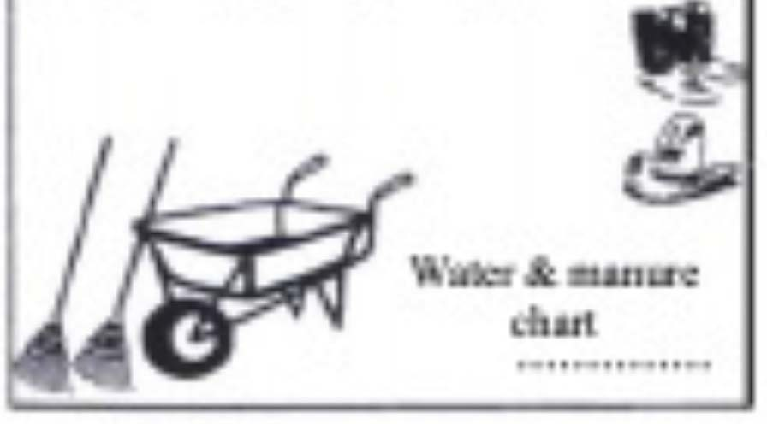

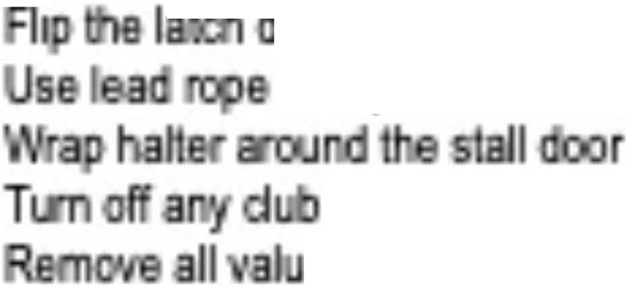



EVERGREEN STATE Fair
SNOH ISH COU TY 4H HORSE PROGRAM
BARN RULES
is a mmsry at the Soo ·s Co111ty 4H o a ram eir Padu! and Evergreen stala 4� Exhi ilD
� Each merrt>er sho d &ti read the Snchomish Countif 4H a f'r'ogMn P Bf1 Ev� stala eir 4- Exhibi!In Handbook i order nders1and ell lhe rules at may affect lhem al Evergreen Sia' Fair.
Barn ltou": The ba are o an rrom 6am 1o 1 OJxn. eed lo siB)' o I lhe ba s open.
ve arr, concerns
, parents, Bf1 ea need lo be out ol lhe barns bafora ·� Bf1
ixn. Vol ms at
ct lhe oei and
che
All slells need to be s
h<nc rail e
Each hone 1
orrcctly from the sin . 11 from opening in
I
the II door
c a�Ddi to the · a_ m a ID oo tbe
l!d inllo the bn,a 11.1me platr 1111 the door of the lnfomutio11 form uld e raid com tly
nr,c,ds
·
stall, 11n
and fit bchmd du: slall an!.
El
uJd be hu.n from the rmg,; on the It wall of the IL
acit .a SBmDle
nn two w g t w
m hu.n at tbe &ont or 11,e sall n safe od Ide: to h11ve cxtr.l w11rer buckets
I I I I I
oth sidie facin the horse.
e tum bigJi enou Jo a horse
Uncxt rand iJy
D4
unless the tnpcd down.,
S.dllm
Members are Al&ponsi le for�
E1
is tutked in aac
Please be &l!Te
Fil b ,(s)
El El El El El
•
iflT1
OJ
E1 Oeanstall
E1 E1 E1
ng mecha is
AIXI en approprials amo111lofbed-� aose doof secure
eled<ooic> or ls
and slell frame
Check nke1s and aoc:e •es foq1roper fit
ables from Iha aisle way
Emerg111cy Contacts
FeirS
Sectio Sectio Sectio
Nig Checits
r
425 737-2700
425 220-
·sor
· r
TBO TBO
Mazzola

Slide 42
Water & Manure Chart – why?
The record of how well your horse is drinking and digesting
Early warning of potential horse health stresses or issues
Scored by Herdsman judges – each shift
Reviewed by nighttime barn crew if a horse is acting oddly or showing signs of colic
One Chart per club per section or as needed

Slide 43
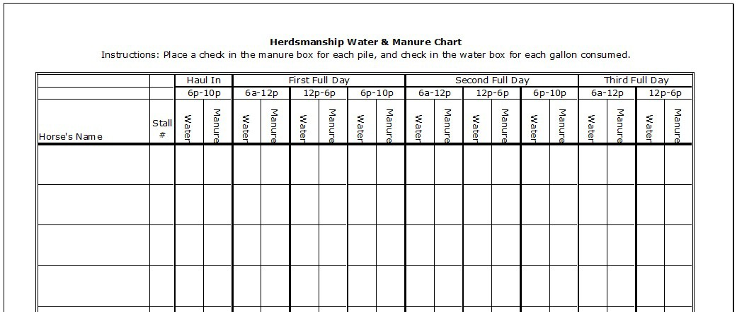
Water & Manure Chart
WHEN to update the chart
WHAT to update

Slide 44


Slide 45
What is Herdsmanship
The Dictionary: a person who owns or watches over a flock or herd
Welcomes the Fair visitors to the Club Exhibit
Maintains the cleanliness of the Club Exhibit
Supervises Fair visitors to ensure their safety and enjoyment – and the horses too
**It may not be practical to be Herdsman while exhibiting

Slide 46
Why is Herdsmanship Important?
Encourage Fair visitors to learn more about horses
Fair visitors may unknowingly do something unsafe or unhealthy with the horses
Fair visitors deserve to see and know how fabulous 4-H is with fun, friendly, nice, tidy, smart and good attitudes

Slide 47
The Job of a Herdsman
– in contrast to the Exhibitor
Herdsman Exhibitor
Cleans aisleway
Welcomes all visitors
Answers visitor questions
Monitors the safety of horses and the public
Knows the whereabouts of all exhibitors
Informs exhibitors if attention is required on their exhibit
Greets and answers all questions of the Herdsmanship Judge(s)
Confirms water & manure charts are up to date
Tops water buckets
Reminds Fair goers not to pet or touch the horses
Maintains a stall free of poo and wet shavings
Adds “ample” clean shavings
Fills water buckets
Feeds hay & grain
Updates water & manure charts
Keeps tack stall(s) and changing room clean and organized
Reports in/out to the Herdsman, Barn Supervisor (adult)
Secures stall with latch, clip and halter
Store all equipment out of public view – keeping stall
front tidy and clean
Be the exhibit, with your horse at your stall
Is prepared and attends classes

Slide 48
HERDS
Barn Hours
6am – 10pm
Members need to be on shift from 10am- 6pm
If horse is present
An adult needs to be in the barn from 6am-10pm
If member/horse is present
BARNS ARE CLOSED BETWEEN 10PM &6AM
Members only in stalls
Horses must be haltered and tied in the stall or have a 2nd person at the stall door while cleaning if the stall door is open
Lead rope and Halter on door when horse is inside
This is for safety of horse getting out and to deter public from opening doors – also needed for quick access for safety purposes
CLUBS – share herds shifts and post on FB you need help
REMINDER ** Parents/Adults do not do herds, sweeping, cleaning, water, etc. from 10am-6pm and never in stalls unless it is an emergency

Slide 49
WHO GETS JUDGED AND HOW for HERDS
Club earns danishes based on the herdsman, cleanliness of the aisle, and the condition of the decorations.
Exhibitor earns danishes based on cleanliness of their horse, stall and water. If a members scores poorly it could negatively affect them going to the State Fair.
Be sure to sign up for Herds when you register
Youth that are only doing Herdsmanship must also register in ShoWorks

Slide 50
Herdsmanship Judging
Herdsmanship is typically judged three times per day
Judged once per shift, per day – be ready at any time, any day
Twice during the day and once at 10pm
Danishes awarded
Results are posted by the office *pick these up daily
We need a volunteer to make a new big danish tracking board to post by the office
Clubs can earn special recognition for top quality work
When you recognize a Herdsman Judge(s)
Address them
Offer to show them the water/manure chart
Answer questions
How many stalls
How many horses
How many riders
Etc.
PLEASE ASIGN A MEMBER TO GO TO THE OFFICE EACH DAY TO GET YOUR HERDS PAPERWORK!

Slide 51
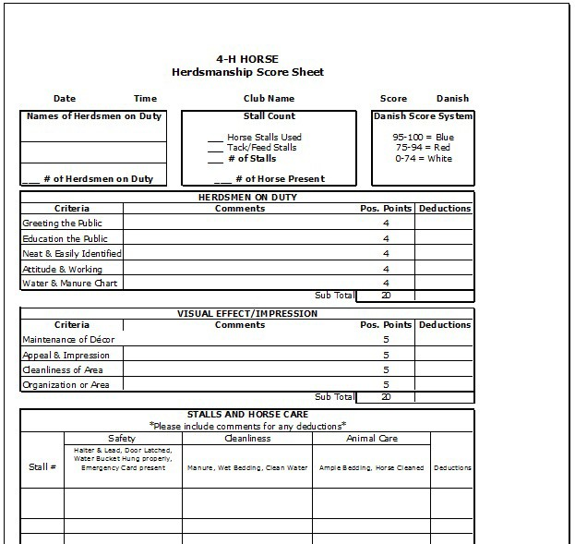
Herdsmen need to provide this
Herdsmen and Exhibitors need to do/provide
Herdsmen and Exhibitors need to do/provide
Exhibitors need to do/provide
20 points
20 points
20 points

Slide 52
What is Barn Supervision
The adult presence in the club’s exhibit
Protect exhibitors and herdsman from risks including people, horses, situations and emergencies
Escalate matters to Club Leader, Fair Section Supervisor(s) and/or Fair Superintendent when necessary
Observe Fair visitors to ensure safety and enjoyment of the horses; interceding when necessary
Clubs can request to be near a club to share parents with

Slide 53
Why is Barn Supervision Important?
Fair visitors may unknowingly do something unsafe or unhealthy with the horses, exhibitors or herdsman
The resource when mature problem-solving is required

Slide 54
The Job of a Barn Supervisor
Be present and visible in the club exhibit at all times
Ensures the buddy-system is used by all youth at all times
Knows the whereabouts of all exhibitors and herdsman at all times
Coordinates buddy system for any herdsman drop-off, pick-ups at front gate
Calls the Superintendent or another Lead when there is an issue - but step in if there are safety concerns immediately, and have someone notify the office

Slide 55
The Job of a Parent/Adult during Fair
Be kind and respectful to all youth, volunteers and Fair visitors at all times
Be supportive and encouraging
Review 4-H and Fair rules and expectations
Comply with 4-H Code of Conduct – behavior & dress
Be a stationary post for the horse
Refrain from going into horse stalls – encourage members to ask/help members
Needed to volunteer for club barn supervisor shifts
We hope you volunteer for at least one County Level Shift

Slide 56
Haul Out / Transition
Please pack up all your items and have your horse out of the barns by 4pm
Have a clean stall waiting for the next member
Clean aisles for next section
All garbage out
Last Day
Have all items out of the barn before 6pm
Clean all stalls and aisles
Leave the barn/stalls better than we found them
Each club is allowed one vehicle on the Fairgrounds to to assist in loading Fair decorations
You must follow Parking Leaders directions for safety

Slide 57
Last Day
Horse Shop pick up
Pack Up
Gather Herdsmanship papers
Leave the barn and stalls cleaner than you found them
WORK TOGETHER AND
THINK OF ALL THE THINGS YOU WANT TO DO FOR THE NEXT Fair

