Slide 1
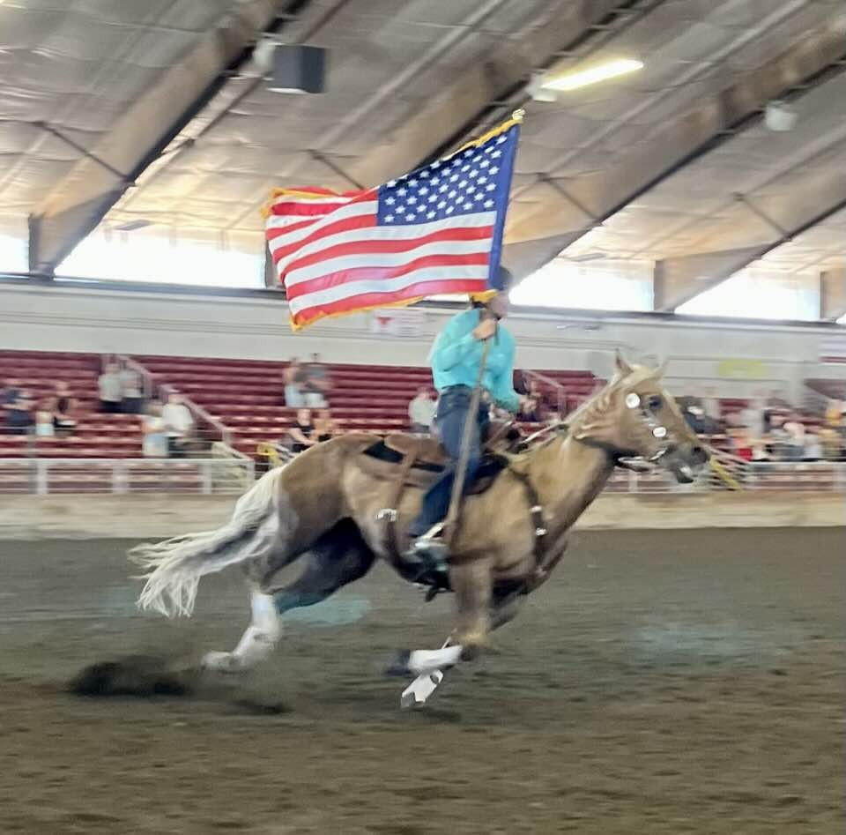
PREPARE FOR Fair PRESENTATION

Slide 2
“Bright Lights, Summer Nights” Fair 2024
Melinda Nelson, Superintendent
425-737-2700
Laurie Johnson, Assistant Superintendent
206-930-3844

Slide 3
You decided to go Fair….
NOW WHAT??

Slide 4
Review Rules and Guidelines
Evergreen State Fair 4-H Horse Exhibitor’s Guide
Dept L
Click HERE
State 4-H Equine Rule Book
Click HERE

Slide 5
Requirements
Membership
Horse Certificate
Judging - contact Melinda if you had issues
Show with horse and rider combination for
Western Games
Hunter Over Fences
Driving
Ranch Riding
Presentation
Record Book
TALK TO Fair SUPERINTENDENT OF ANY CONCERNS

Slide 6
NEED TO KNOW
THEME
FLEXIBILITY AND PATIENCE
No food in aisles of barns
Fair Rules
No dogs in the horse park
No bikes, skateboards etc.
No overnight sleeping in the barns
No parking in fire lanes
See Fair rules for more info
Snohomish County 4-H Rules
Horse show etiquette
Refer to County Reference Guide
When and how to talk with the judge
Make arrangements with office after your section is complete
No coaching from the rail during a class
Helmet
Ensure good fit
Hoof Black
May NOT do it directly on aisle - must use card board or other material - outside or in stall
Applies to:
✓
✓
4-H Members
✓
✓
Adult Supervisors
✓
“Withs” during shift
✓
Enrolled Volunteers
Anyone in the barns/exhibit
Anyone representing 4-H

Slide 7
NEED TO KNOW
Display of unsportsmanlike conduct is prohibited
Animal abuse of any kind is prohibited and will not be tolerated
Take out garbage and pack up food regularly to avoid rodents and insects
Smoking, use of tobacco, vaping, alcohol or drugs (other than those directed by a doctor) is not allowed
Possession of a weapon other than that appropriate for program activities is not allowed
Language must be controlled and appropriate - no swearing, no behavior that would cause embarrassment (including excessive public displays of affection) or emotional, physical, verbal, mental or sexual abuse to others
Applies to:
✓
✓
4-H Members
✓
✓
Adult Supervisors
✓
“Withs” during shift
✓
Enrolled Volunteers
Anyone in the barns/exhibit
Anyone representing 4-H

Slide 8
Code of Conduct
Applies to…
Members
Dress & Grooming
Clothing shall not be revealing or offensive in nature.
Straps on sleeveless shirts must be 3 fingers wide or wider (approx. 2”)
No bare midriffs
No low-cut tops or pants that reveal underwear
Shorts/skirts must be no shorter than the tips of the fingers when arms are held at the sides of the body
Any slogan or insignia on clothing that implies discrimination, ridicule, intimidation or profanity is unacceptable
Any display of pictures in reference to or words depicting alcohol, tobacco, illegal substances or sexual innuendo on any clothing is unacceptable
Any display of pictures in reference to or words depicting guns or weapons, unless project related, is unacceptable
Parents
Volunteers
Anyone representing 4-H
Other items deemed inappropriate by 4-H facilitators, representatives or staff are
unacceptable
If in doubt, don’t wear it

Slide 9
Members
Sign up on ShoWorks
Must enter by July 26th
Click HERE
Enter as many classes as you wish
No cross entering
Paid for 9 premium paying classes (you may enter more)
Print copy for your own records

Slide 10
LEADERS
Forms we need back
DUE August 2nd
Send entire packet to
Fairsuperintendent@snoco4-hhorse.com
These are fillable online forms
Forms you need to give to your leader
These are fillable online forms and will be in a packet file – just forward to your leader's email

Slide 11
Continue to …….
Practice
Record Books
Horse Health
Vaccines recommended
Vaccines should be given at least 2 weeks prior to haul in
Please consult your vet for recommendations
Check for bot eggs and remove them
Farrier
Skin issues
De-Worm

Slide 12
What to Bring….
Members
Tack
Show clothes
Regular clothes
Dress Code
Horse Food / Supplements
If your horse is on a Rx – please have vet letter available at vet check

Slide 13
What to Bring….
Club
Curtains
Valances
Décor
Ways to hang
ladder, poles, wire, etc.
Tools to remove
nails/tacks etc.
Chairs
Totes

Slide 14
Waivers and Hardships
Judging Waiver Request
If you were unable to complete one of the four Horse Judgings
Please contact Melinda if you missed a judging and explain circumstances
4-H Hardship Form
Loss of horse, injury, loss of lease, sold, any unexpected change, etc..
Copy of Completed Horse Certificate on non-project horse
Signed by member, parent, leader
Copy of Veterinarian’s Statement on project horse (if applicapble)
No premium money and cannot qualify for state, if approved

Slide 15
MEDICAL RELEASE
Each exhibitor must have a Medical Release to be at Fair. IF YOU RE SHOWING IN MULTIPE SECTIONS YOU MUST HAVE 1 FORM PER SECTION
***No exceptions, without this form the exhibitor will not be allowed to participate
MEMBERS ARE TO BRING THIS FORM TO THE MADITORY MEETING

Slide 16
PARKING PASSES, RV AND Fair PASSES
Fairgrounds will be sending a link for clubs to purchase
We will make a post to have you check your emails once we get notification
Club will order passes for their members and families
RV Reservation
Click HERE

Slide 17
Stall Preparation
Sunday August 18th-August 21st
Pressure Wash and Disinfect (no bleach allowed)
Sunday ONLY from
9am-3pm
Decorating begins at 3:00pm on Sunday the 18th
Ends on Wednesday the 21st
Must be complete before Fair opens
NO MORE SPRAYING WATER AFTER SUNDAY – WILL DESTROY OTHERS DÉCOR
**Please do not blow dirt or garbage into another club's area
**Remove it from the barn

Slide 18
STALL REQUIREMENTS
Valances on all stalls used by the club
Curtains to cover all tack / changing / equipment areas
Informational Poster
For Member and Horse
Helmets required in photos if mounted
Educational Poster
Buckets
Two buckets for each horse
1 bucket for a mini, can have more buckets if needed
Can be on the ground with handle secured or removed
Must be hung with snap clip (any clip should be away from horses face)
Halter and clip to secure stall door
**All buckets and hay bag need to be secured and must be hung above the horses chest
**Only minis can have water buckets on the ground
**Openings of the hay net cannot be more than 2”

Slide 19
Stall Setup and Safety Check
A community service project to clean our Fairgrounds horse stalls
(no bleach)
A safety consideration to ensure our horses, members and Fair visitors are welcomed with a clean exhibit
Remove all staples, nails, screws, zip ties, twine, tape, gum, wire, hooks, etc. from inside stalls, outside stalls, support beams, etc.
Report any stall repair issues – sticking stall doors, broken latches, stall floor issues, etc.
Report any stall safety issues – sharp sheet metal, broken rails, broken boards, etc.
Everything should be cleaned – before anything is decorated

Slide 20
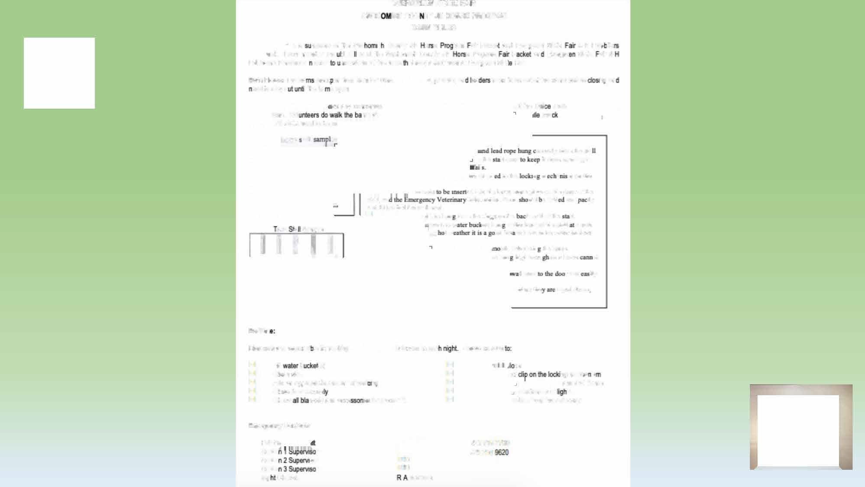
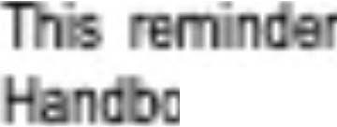
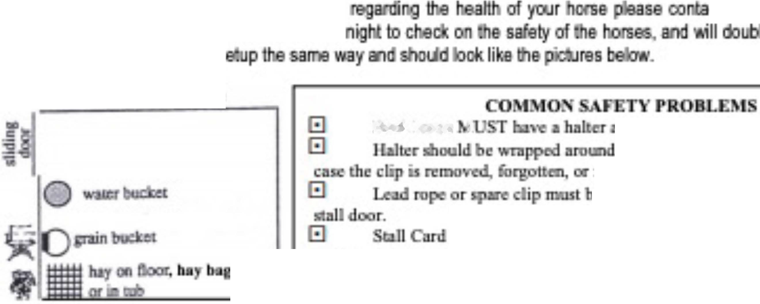
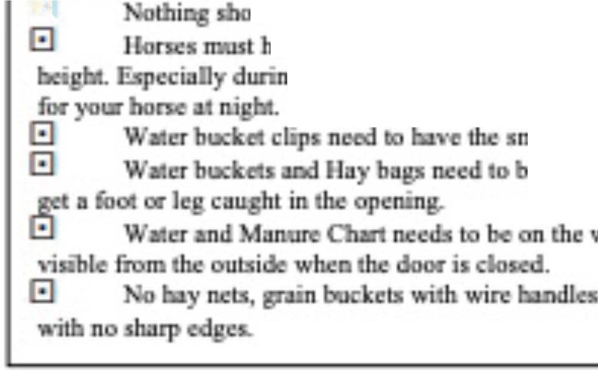
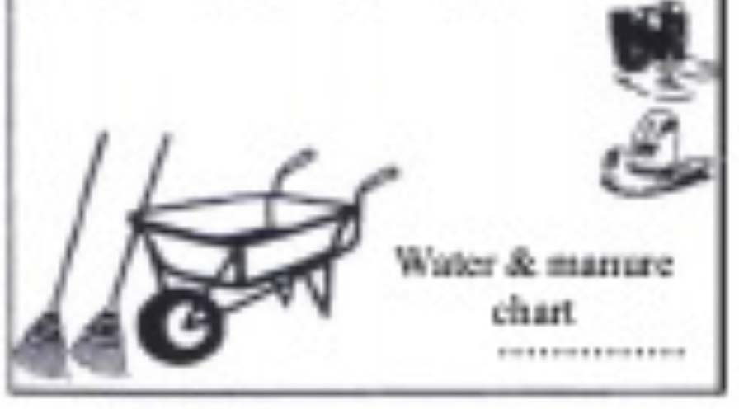
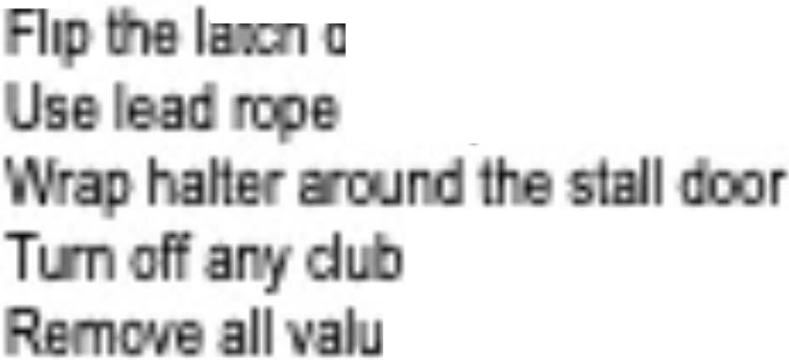
EVERGREEN STATE Fair
SNOH ISH COU TY 4H HORSE PROGRAM
BARN RULES
is a mmsry at the Soo ·s Co111ty 4H o a ram eir Padu! and Evergreen stala 4� Exhi ilD
� Each merrt>er sho d &ti read the Snchomish Countif 4H a f'r'ogMn P Bf1 Ev� stala eir 4- Exhibi!In Handbook i order nders1and ell lhe rules at may affect lhem al Evergreen Sia' Fair.
Barn ltou": The ba are o an rrom 6am 1o 1 OJxn. eed lo siB)' o I lhe ba s open.
ve arr, concerns
, parents, Bf1 ea need lo be out ol lhe barns bafora ·� Bf1
ixn. Vol ms at
ct lhe oei and
che
All slells need to be s
h<nc rail e
Each hone 1
orrcctly from the sin . 11 from opening in
I
the II door
c a�Ddi to the · a_ m a ID oo tbe
l!d inllo the bn,a 11.1me platr 1111 the door of the lnfomutio11 form uld e raid com tly
nr,c,ds
·
stall, 11n
and fit bchmd du: slall an!.
El
uJd be hu.n from the rmg,; on the It wall of the IL
acit .a SBmDle
nn two w g t w
m hu.n at tbe &ont or 11,e sall n safe od Ide: to h11ve cxtr.l w11rer buckets
I I I I I
oth sidie facin the horse.
e tum bigJi enou Jo a horse
Uncxt rand iJy
D4
unless the tnpcd down.,
S.dllm
Members are Al&ponsi le for�
E1
is tutked in aac
Please be &l!Te
Fil b ,(s)
El El El El El
•
iflT1
OJ
E1 Oeanstall
E1 E1 E1
ng mecha is
AIXI en approprials amo111lofbed-� aose doof secure
eled<ooic> or ls
and slell frame
Check nke1s and aoc:e •es foq1roper fit
ables from Iha aisle way
Emerg111cy Contacts
FeirS
Sectio Sectio Sectio
Nig Checits
r
425 737-2700
425 220-
·sor
· r
TBO TBO
Mazzola

Slide 21
Hauling-In a Horse – Changeover
Before you arrive, 4-H members should…
Have your signed horse certificate (copy or digital)
Have your emergency vet check form
Enter the equestrian park from 179th Avenue between 5:30-7:30pm on haul-in day. Too early, you
Follow the directions of the Fair and 4-H volunteer parking crews - horse trailers are directed into the Fairgrounds and behind barn 106 – all other traffic is directed to the parking lot
Driver stops in unloading area – where directed – next to arena 109
Unload the horse(s)
With horse certificate & emergency vet check form in hand, 4-H member leads the horse into vet check area – arena 109
Driver leaves unloading area – to park or leave the Fairgrounds
Stand in line for Vet Check – be sure to keep horses apart and avoid petting other horses until after vet check
Horse should not have blankets / sleezies / shipping boots off to cool
DO NOT UNLOAD TACK OR EQUIPMENT UNTIL TRAILER IS PARKED OUTSIDE THE FAIRGROUNDS
EVERYONE handling horses MUST have proper footwear (hard soled /totally enclosed )
will be turned away; too late and you will need to contact Fair Superintendent 425-737-2700

Slide 22
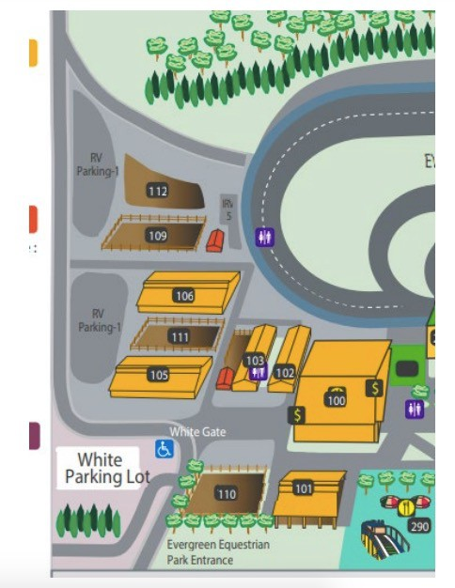
Follow red arrows
Trailers ^^
Stop to unload HORSE only

Slide 23
HAUL IN …..
Vet Check
Emergency Vet Information Form
One Vet Emergency Information Form per section
Horse does not need 2nd vet check if it has not left the Fairgrounds (unless you have concerns)
Each exhibitor will need to fill out the Emergency Veterinarian Information Form for each horse for each section
This form will be turned in at orientation during their section
If showing more than one section, multiple forms will be required
Please add exhibitor number next to name
Horse Certificate
Digital or hard copy
We will do a soundness check at vet check - jog away and back towards veterinarian
You must include any medications your horse may be taking on the emergency vet form

Slide 24
What to Expect in Vet Check
Temperature: must be under 101 to pass vet check, temperatures between 101 and 102 from trailering are allowed time to cool down and retest
Please make sure your horse allows its temperature to be taken rectally
Pulse & Respiration
Mucus membrane color & Capillary refill time
Overall examination looking at the health and condition of your horse
Horses with infectious nasal or ocular discharge or other signs of infectious disease may not pass
Lameness, poor hoof care affecting gait, open wounds, girth galls/sore backs will not pass
Horses must be free from visible parasites (bot eggs, lice)
Henneke Body Condition Score (BCS) should be between 4 - 7

Slide 25
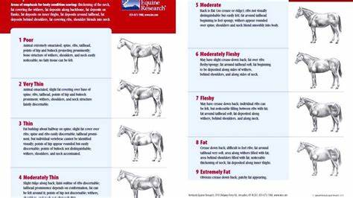
BODY SCORING

Slide 26
STALL CARD …..
Stall Card
Front
Stall Number
Horse Name
Owner Name – First Name ONLY
Rider number
* if horse has odd or aggressive behavior
Back
Phone number
an adult who can authorize and will be financially responsible for vet care
* Description of odd or aggressive behavior that the night time barn
crew may need to be aware of
Describe any stall habits (may bite; lays down frequently; pushy) also any medications the horse may be on
RV Location if on Fairgrounds

Slide 27
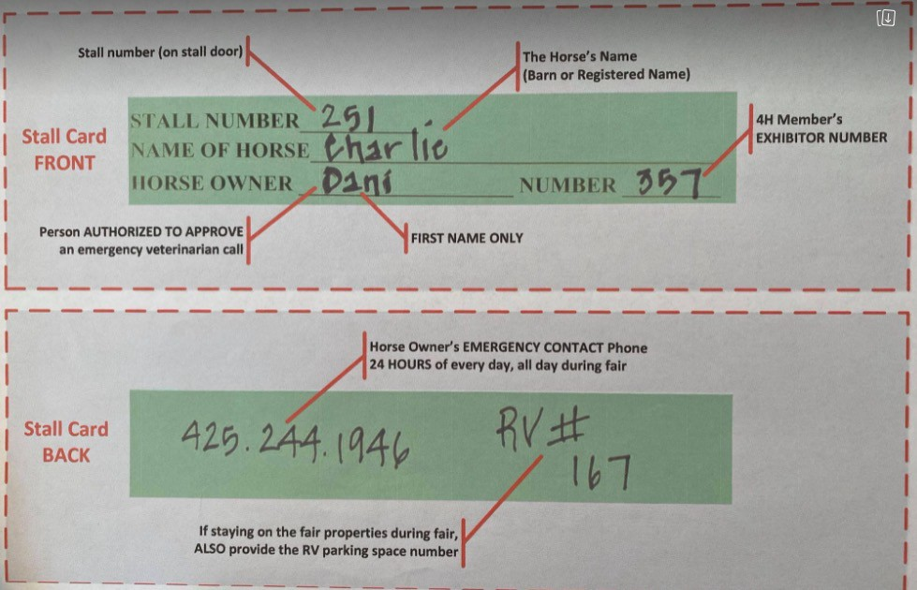
*
*Horse Bites and Weaves

Slide 28
YOUR HORSE’S STALL…..
Stalls
2 Buckets per stall full of water (more allowed)
Minis can have 1 Bucket or more (ground is ok if handle is secured or removed)
Hay net less than 2” in diameter
Hay bag ok
Shavings – keep clean
Stall card (on door)
Valance
Informational Poster
Horse info / Rider info
Educational Poster
Mini Horses
Water buckets do not have to be hung
Gate is allowed for stalling with member present
Manure and Water Chart
Office will have these

Slide 29
PRE MEETING…..
Arena 100
Get number
Verify classes are correct
You can only correct classes before and after the Mandatory Meeting on haul in night
Get Manure / Water Chart (per section / per club)
Watch for patterns to be posted

Slide 30
MANDITORY MEETING…..
Mandatory Meeting
Must bring Medical Release Form and Emergency Vet Form to Orientation
Must put Stall # on forms
Must attend orientation to be able to participate at Fair
Meet
Section Supervisors
Judge
Ask questions and learn what they would like to see

Slide 31
What is Herdsmanship (R-A Mazzola)
The Dictionary: a person who owns or watches over a flock or herd
Welcomes the Fair visitors to the Club Exhibit
Maintains the cleanliness of the Club Exhibit
Supervises Fair visitors to ensure their safety and enjoyment – and the horses too
**It may not be practical to be Herdsman while exhibiting

Slide 32
Why is Herdsmanship Important?
Encourage Fair visitors to learn more about horses
Fair visitors may unknowingly do something unsafe or unhealthy with the horses
Fair visitors deserve to see and know how fabulous 4-H is with fun, friendly, nice, tidy, smart and good attitudes

Slide 33
HERDS
Barn Hours
6am – 10pm
Members need to be on shift from 10am- 6pm
If horse is present
An adult needs to be in the barn from 6am-10pm
If member/horse is present
BARNS ARE CLOSED BETWEEN 10PM &6AM
Members only in stalls
Horses must be haltered and tied in the stall or have a 2nd person at the stall door while cleaning if the stall door is open
Lead rope and Halter on door when horse is inside
This is for safety of horse getting out and to deter public from opening doors – also needed for quick access for safety purposes
CLUBS – share herds shifts and post on FB you need help
REMINDER ** Parents/Adults do not do herds, sweeping, cleaning, water, etc. from 10am-6pm and never in stalls unless it is an emergency

Slide 34
Water & Manure Chart – why?
The record of how well your horse is drinking and digesting
Early warning of potential horse health stresses or issues
Scored by Herdsman judges – each shift
Reviewed by night time barn crew if a horse is acting oddly or showing signs of colic
One Chart per club per section

Slide 35
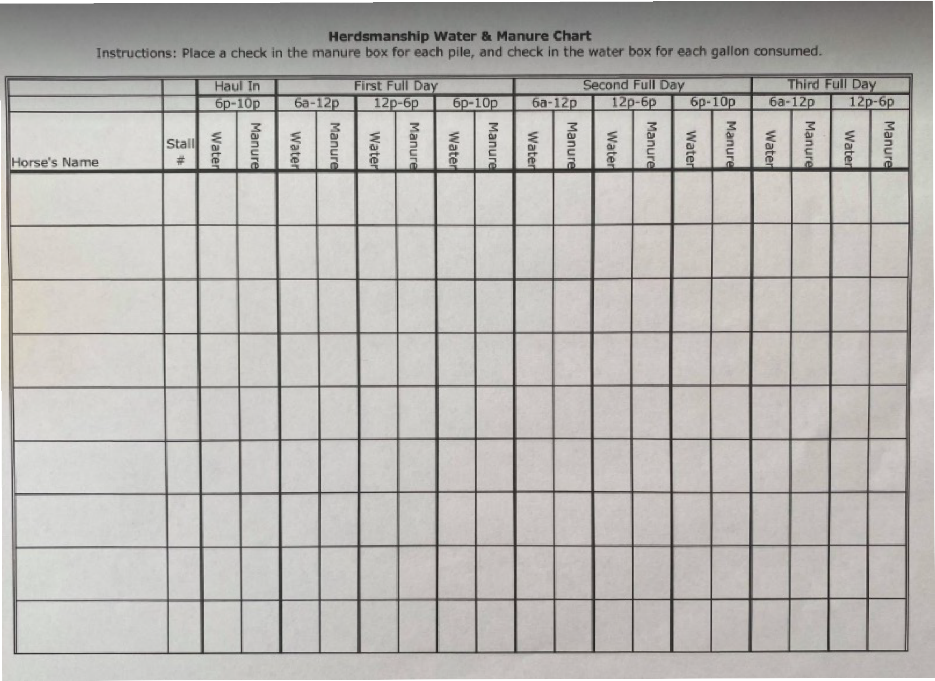

Slide 36
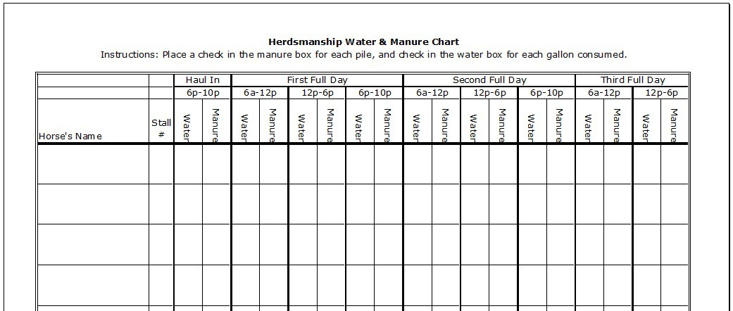
Water & Manure Chart
WHEN to update the chart
WHAT to update

Slide 37
The Job of a Herdsman
– in contrast to the Exhibitor
Herdsman Exhibitor
Cleans aisleway
Welcomes all visitors
Answers visitor questions
Monitors the safety of horses and the public
Knows the whereabouts of all exhibitors
Informs exhibitors if attention is required on their exhibit
Greets and answers all questions of the Herdsmanship Judge(s)
Confirms water & manure charts are up to date
Tops water buckets
Reminds Fair goers not to pet or touch the horses
Maintains a stall free of poo and wet shavings
Adds “ample” clean shavings
Fills water buckets
Feeds hay & grain
Updates water & manure charts
Keeps tack stall(s) and changing room clean and organized
Reports in/out to the Herdsman, Barn Supervisor (adult)
Secures stall with latch, clip and halter
Store all equipment out of public view – keeping stall
front tidy and clean
Be the exhibit, with your horse at your stall
Is prepared and attends classes

Slide 38
Herdsmanship Judging
Herdsmanship is typically judged three times per day
Judged once per shift, per day – be ready at any time, any day
Twice during the day and once at 10pm
Danishes awarded
Results are posted by the office *pick these up daily
We need a volunteer to make a new big danish tracking board to post by the office
Clubs can earn special recognition for top quality work
When you recognize a Herdsman Judge(s)
Address them
Offer to show them the water/manure chart
Answer questions
How many stalls
How many horses
How many riders
Etc.
PLEASE ASIGN A MEMBER TO GO TO THE OFFICE EACH DAY TO GET YOUR HERDS PAPERWORK!

Slide 40
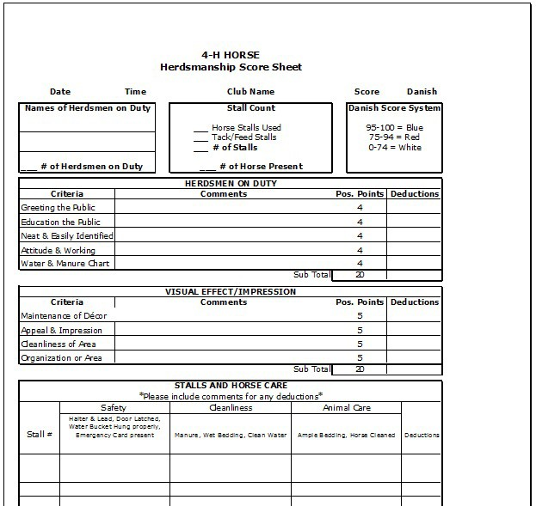
Herdsmen need to provide this
Herdsmen and Exhibitors need to do/provide
Herdsmen and Exhibitors need to do/provide
Exhibitors need to do/provide
20 points
20 points
20 points

Slide 41
WHO GETS JUDGED AND HOW for HERDS
Club earns danishes based on the herdsman, cleanliness of the aisle, and the condition of the decorations.
Exhibitor earns danishes based on cleanliness of their horse, stall and water. If a members scores poorly it could negatively affect them going to the State Fair.
Be sure to sign up for Herds when you register
Youth that are only doing Herdsmanship must also register in ShoWorks

Slide 42
What is Barn Supervision
The adult presence in the club’s exhibit
Protect exhibitors and herdsman from risks including people, horses, situations and emergencies
Escalate matters to Club Leader, Fair Section Supervisor(s) and/or Fair Superintendent when necessary
Observe Fair visitors to ensure safety and enjoyment of the horses; interceding when necessary
Clubs can request to be near a club to share parents with

Slide 43
Why is Barn Supervision Important?
Fair visitors may unknowingly do something unsafe or unhealthy with the horses, exhibitors or herdsman
The resource when mature problem-solving is required

Slide 44
The Job of a Barn Supervisor
Be present and visible in the club exhibit at all times
Ensures the buddy-system is used by all youth at all times
Knows the whereabouts of all exhibitors and herdsman at all times
Coordinates buddy system for any herdsman drop-off, pick-ups at front gate
Calls the Superintendent or another Lead when there is an issue - but step in if there are safety concerns immediately, and have someone notify the office

Slide 45
The Job of a Parent/Adult during Fair
Be kind and respectful to all youth, volunteers and Fair visitors at all times
Be supportive and encouraging
Review 4-H and Fair rules and expectations
Comply with 4-H Code of Conduct – behavior & dress
Be a stationary post for the horse
Refrain from going into horse stalls – encourage members to ask/help members
Needed to volunteer for club barn supervisor shifts
We hope you volunteer for at least one County Level Shift

Slide 46
Dressage
Fill out Dressage Participation Form for each Dressage rider participating to include in Fair Packet and attach a copy of the confirmation to this form
Please keep in mind that time restraints at Fair may limit riders to one test

Slide 47
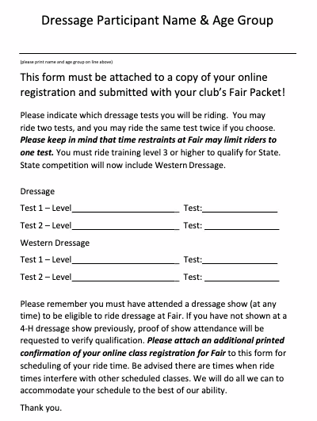

Slide 48
Horse Shop
Monday August 19th 4pm-7pm
Bring in your:
Photography
Paintings
Educational
Art work
Pottery
Drawings
Homemade tack
Homemade clothing
Crafts
Posters
Model Horse items
BE CREATIVE and HAVE FUN
SEE DEPT L FOR MORE DETAILS
ITEM MUST BE FROM THE CURRENT YEAR

Slide 49
Horse Shop Pickup
Pick up horse shop entries; horse photography; memorial posters and informational displays
Thursday – August 29th
From 1pm-3pm
Please ensure pick up happens – it is difficult for activity supervisors to take, store and arrange delivery of forgotten items. You may have someone else pick up for you.

Slide 51
DEMONSTRATIONS
Horse Shop Division
Department L – Horses
Entry deadline is Monday August 12, 2024
Online sign up only
sign up for times for demonstrations – see general schedule
DEMONSTRATIONS Class Code --Limit one (1) per exhibitor
2LB10 – Demonstrations for Juniors, Intermediates and Seniors
9LB10 – Demonstrations for Clover Buds

Slide 52
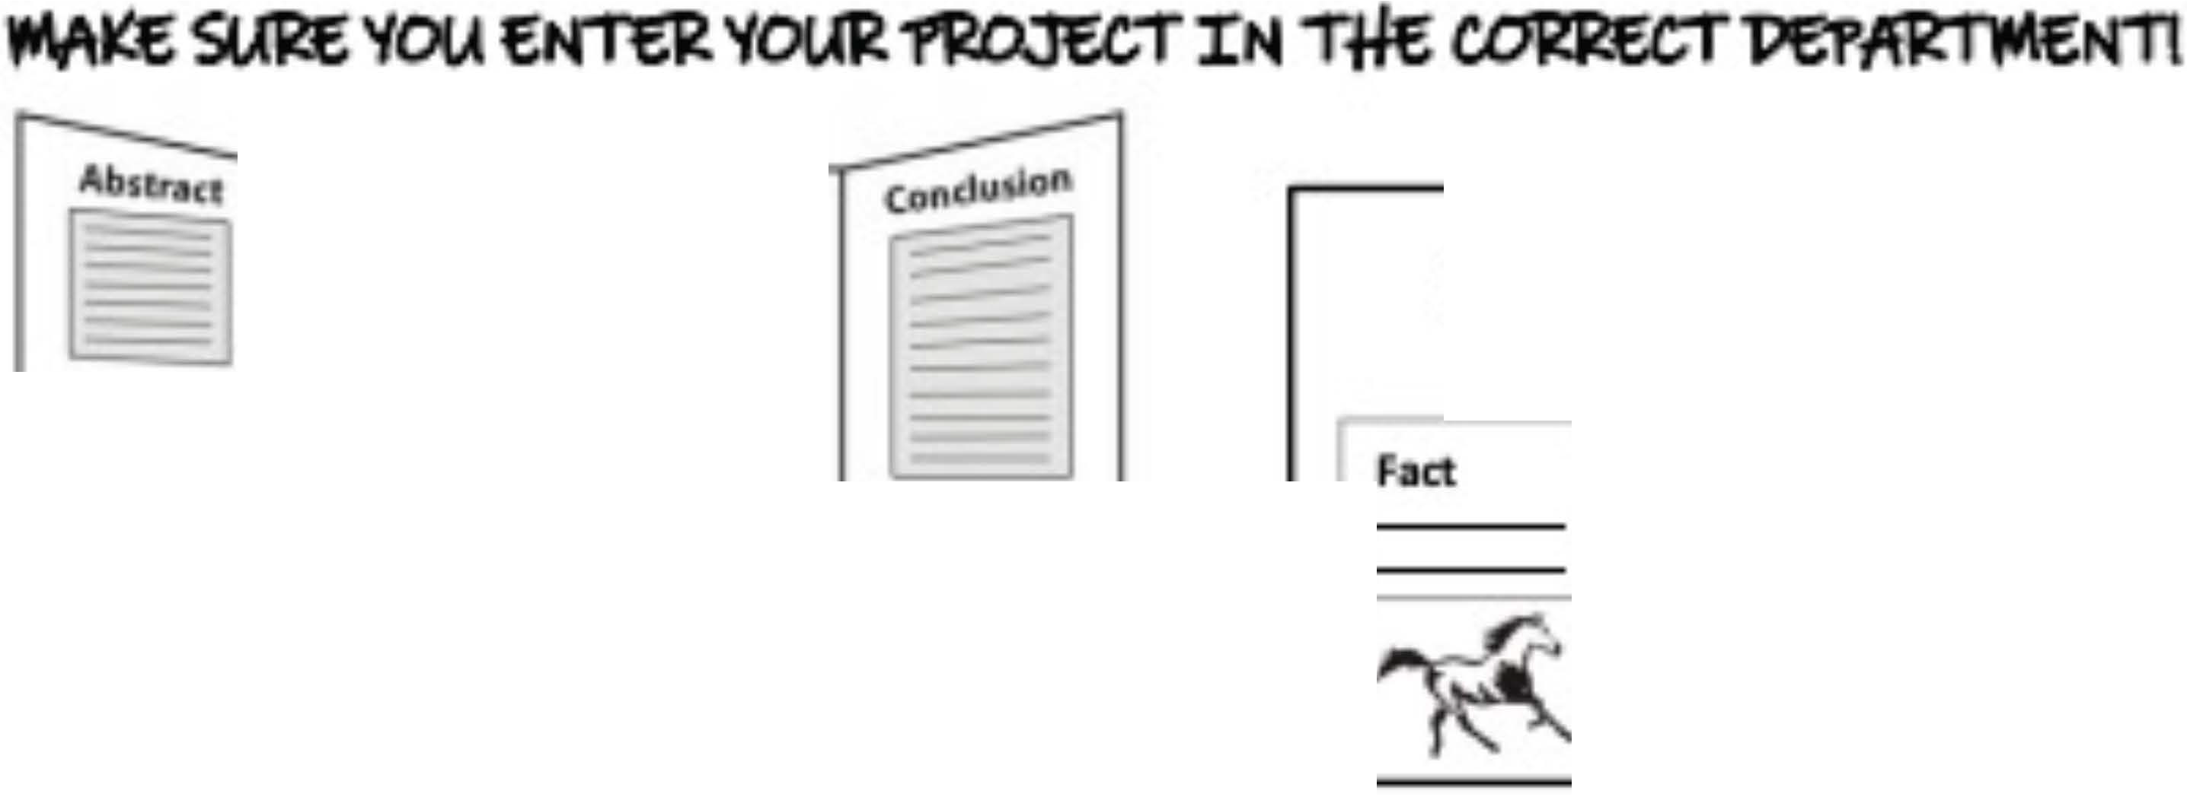
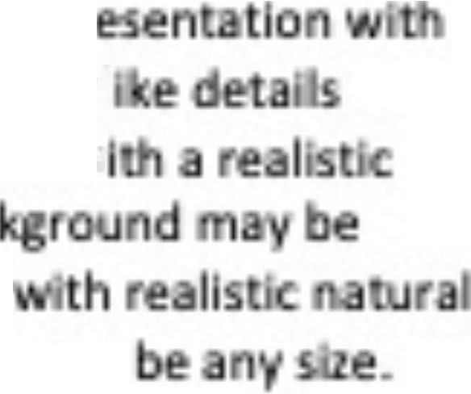
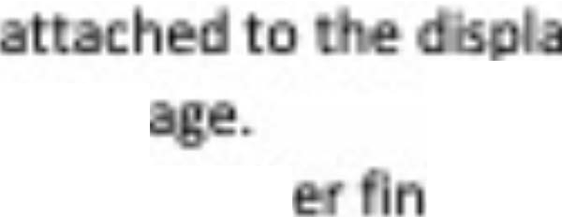
UA
You c.an enter Informational Posters and Educ.at ooal Displays at Fal1 to Ip educate the pu le about hones and OUJ program (plus get a llttle extra preml m cash!). Check In your reg stered exhl Its to t^{h}e Horse Shop room on Monday efore Fair starts: Au9llt 23, 20Z1. 4Pm - '7pm. Pldc them up Thwsday when lnterm tes are released: Sepllmbat � 2021,.. Upm • Jpn. See below for other deta Is, registration deMII nes. and helpful hlntrl
Proj ctTtde
•aoJltT TITll
dlapram
-6
��
Info -i
-1
Q
_,_
_-==R =-==--......._..:::::5--
Tri-fold displays are n e.xampl o EDUCATIO AL DI.SPLAY- DEPARTMENT Z
I.e. Z05Dl .ls the e11try cod for a sentor �Jd boord (/reHtandJng)
Flat posters are n ellam e of INFORMATIONAL EXHIBIT- DEPARTMENT Y
.e. ZL Ya1 .IS the e11 ry code fºr o Junior PMttt
{/lot.. to H hung on the dis lay wall) Register on ne : A1J1ust 16, 2021
I Educational Displays
cn·eco a & Dcfioitioru
En es fall Into me
FREE STAND
ront n a on ta e, b
R er onllne by: A t 1.6, 2021 {4pm)
- · er cc0<dln : l be self-
Id). Ma sit
r support.
DYN
ew In"°
etc.
01 ORAMA - A scenic repr sculptured f res and lifel
volves the lid nt ot n
ct rd:s,
THREE jl) DIMENSIONAL- Dlspl
c th
col
p Ides (not pictures)
so as to blend w nd. b c
be scene
es requ ed to reach
d b p
ec:t. It could be
cles op t Iv I led
n
to use a /or
ngs. FJtures v
function (Le. grooml ols).
I objects must b secw
not d act fro the dlspl mess
B e r bbon winners will be ,eleased ft
v to old loss. This must be done ne tlv nd must
Jud In on D t 7pm.

Slide 54
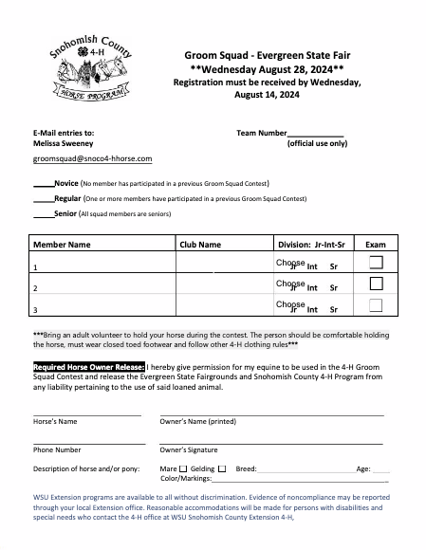
Groomsquad
Wednesday, August 28th @ 6:30pm

Slide 55
Groomsquad
Groom Squad Registration must be completed and either included in Fair Packet or can be mailed in by the deadline on the form.
Registration must be received by August 14th, 2024
Wednesday August 28th, 2024 6:30 PM
SENIOR TEAM CAN QUALIFY FOR STATE

Slide 57
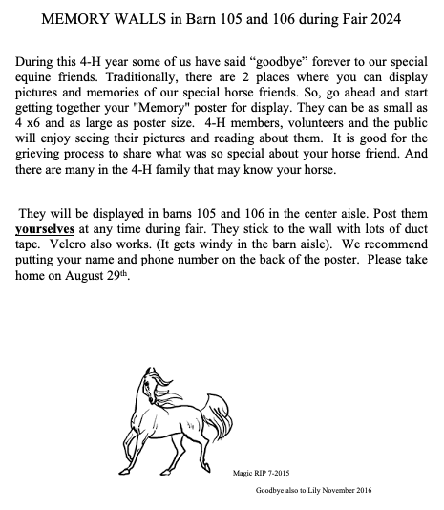

Slide 58
STICK HORSE WORKSHOP
August 25th
Build your horse from 10:00am until Noon
Show your horse from 11:00am through 2:00pm throughout the park
Performance Class at about 1:30pm in the Outdoor Covered Arena

Slide 59
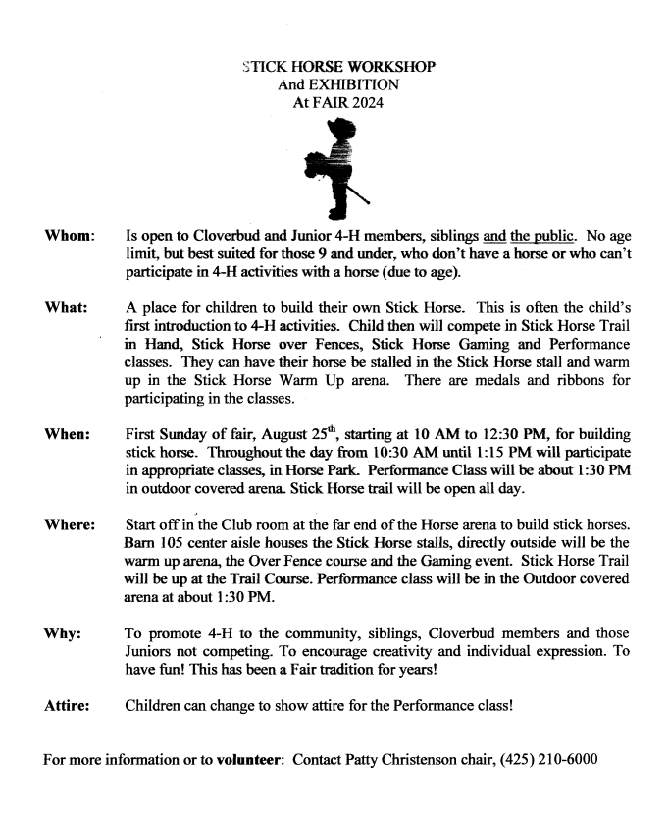

Slide 61
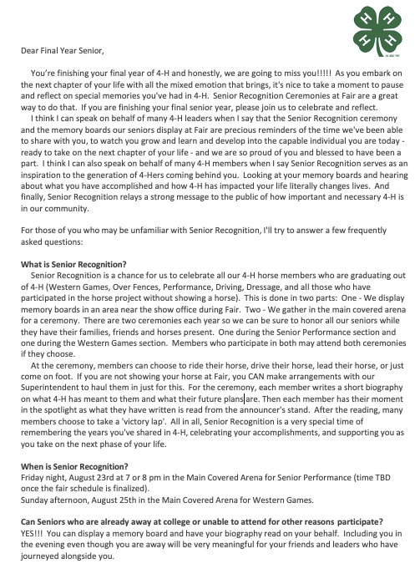
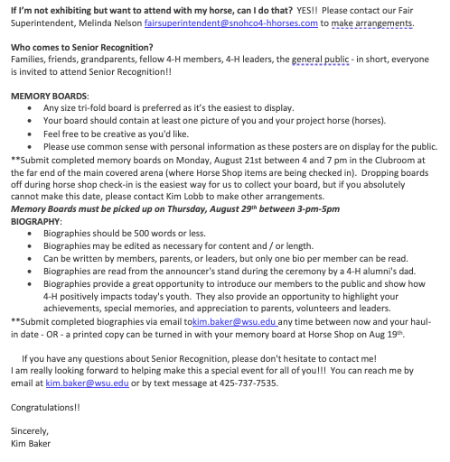
SENIOR RECOGNITION

Slide 62
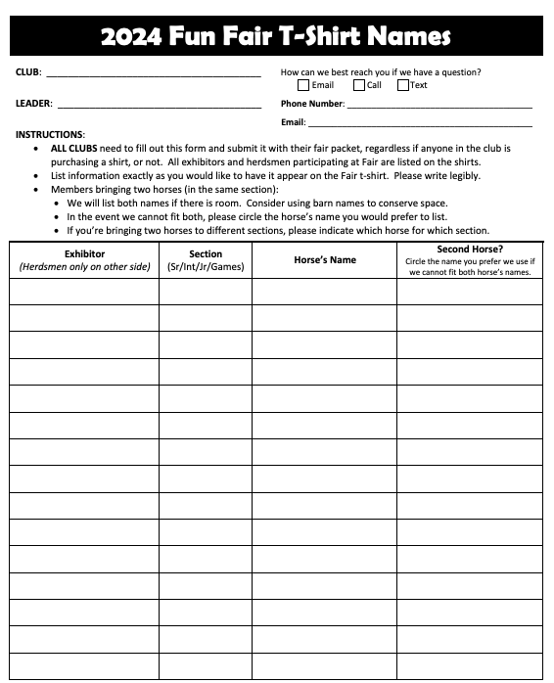
FUN Fair T-SHIRT https://sc4hfunfair2024.itemorder.com/shop/home/ Orders close June 30th

Slide 63
VOLUNTEERS
We will be using Sign-up Genius again this year for Fair
Below is a copy of the volunteer descriptions
Signup Genius
Watch the Facebook page for shifts available
Many positions DO NOT require the person to be an enrolled Volunteer!

Slide 64
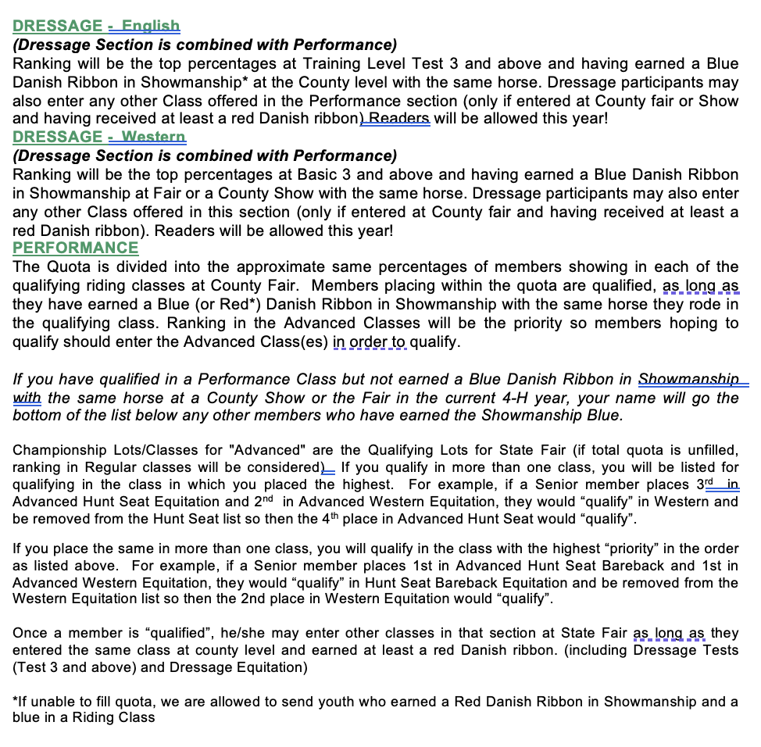
State Fair Qualifying

Slide 65
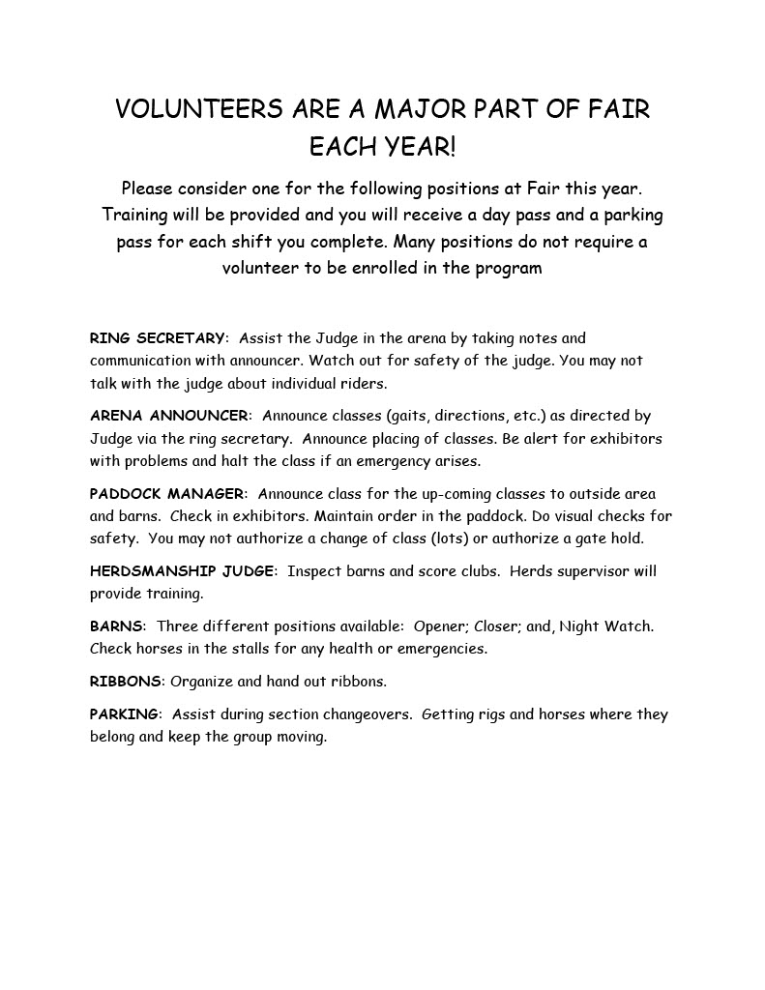
VOLUNTEERS

Slide 66
Haul Out / Transition
Please pack up all your items and have your horse out of the barns by 5pm
Have a clean stall waiting for the next member
Clean aisles for next section
All garbage out
Last Day
Have all items out of the barn before 6pm
Clean all stalls and aisles
Leave the barn/stalls better than we found them
Each club is allowed one vehicle on the Fairgrounds to to assist in loading Fair decorations
You must follow Parking Leaders directions for safety

Slide 67
Last Day
Horse Shop pick up
Pack Up
Gather Herdsmanship papers
Leave the barn and stalls cleaner than you found them
WORK TOGETHER AND
THINK OF ALL THE THINGS YOU WANT TO DO FOR THE NEXT Fair

Slide 68
Fair Committee Roster

Slide 69
SECTION SUPERVISORS
Senior Section – TBD
Gamers/Junior Section – Katie Antonio 425-765-0687
Intermediate Section – Jennifer Munson 425-471-452

Slide 70
Schedules
Fun Games
Times will be announced each Section if time allows for fun games.
Draft Horses
There is an evening show each day except Wednesday August 28th .There are 2 shows on
Sunday August 25th
Costume Class
Ethnically correct
Lead person
Flags
Open to Regular Riders only. There will be Try Outs, sign up in Arena 100.
Please listen to announcements for changes to schedules
Seniors ~ August 21-24
Juniors/Western Games ~ August 24-26
Intermediates ~ August 26-August 29

Slide 71
SCHEDULES
Do not enter into Callback Classes online
These will only be used if we have big classes and need to have lots to divide the class size up
No cross entering – must stay in Regular, W/T/J, Novice etc..
Medals riders MUST be in advanced classes for the classes they are in medals for
Listen for changes
Signup for Herds on ShoWorks during your section regardless of when you are scheduled with your club

Slide 72
Other Fair Activities
State Fair Meetings
Senior Section
Sunday August 25th
7pm in the Clubroom
Intermediate Performance/Dressage, Harness, and Sr/Int Games
TBD
Public Presentations
Patty Christiansen will contact you for your time to do a presentation while at Fair
Premium qualifying
Best to signup for a time at Horse Shop intake

Slide 73
INFORMATION AND UPDATE LOCATIONS
Horse Program Website
http://snoco4-hhorse.com/
4-H Evergreen Fair Website page
Evergreen Fair | (snoco4-hhorse.com)
Horse Program Facebook Page https://www.facebook.com/groups/SnohomishCO4HEquine
Instagram @snoco4Hhorse

Slide 74
Fair ROCKS BECAUSE OF YOU
LET’S HAVE SOME FUN!

